Slide 1
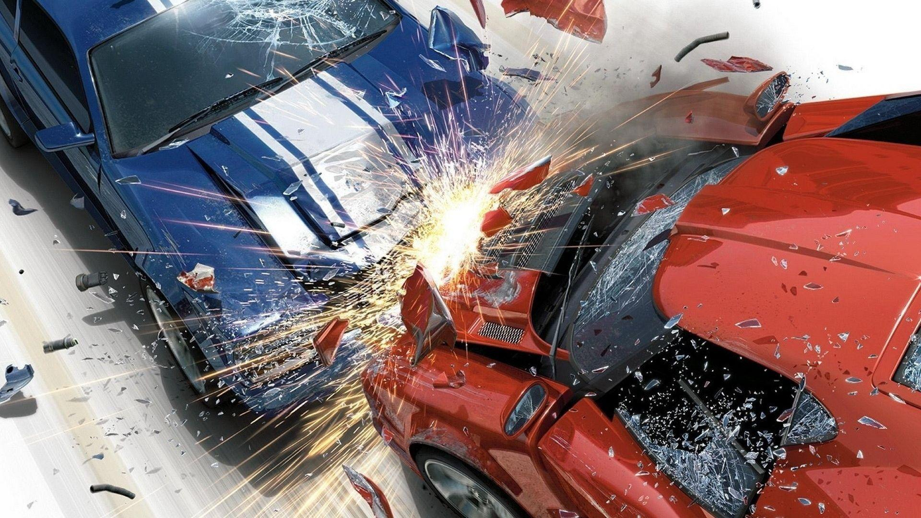
Real-time Collision Avoidance System

Slide 2
Group Members
Bratita Das
Tamjid Iqbal
Rakib Abdullah
Mashfiq Rayhan

Slide 3
THIS SYSTEM IS CONSISTS OF VARIOUS LOW COST DEVICES SUCH AS ULTRASONIC SENSOR NODE (USN), SPEED SENSOR, MICROCONTROLLER AND GPS

Slide 4
BLOCK DIAGRAM
Speed Sensor
Display
GPS
MicrocontrollerMicrocontrollerMicrocontroller
Microcontroller
Power Supply
Ultrasonic Sensor

Slide 5

Hardware
To Complete This Project We Need Various Kinds Of Equipment Such As
Microcontroller (Arduino Due)
Power supply unit (Battery)
Display Unit (LED/LCD)
UltraSonic Sensor
Speed Sensor
GPS
Dc Motor

Slide 6
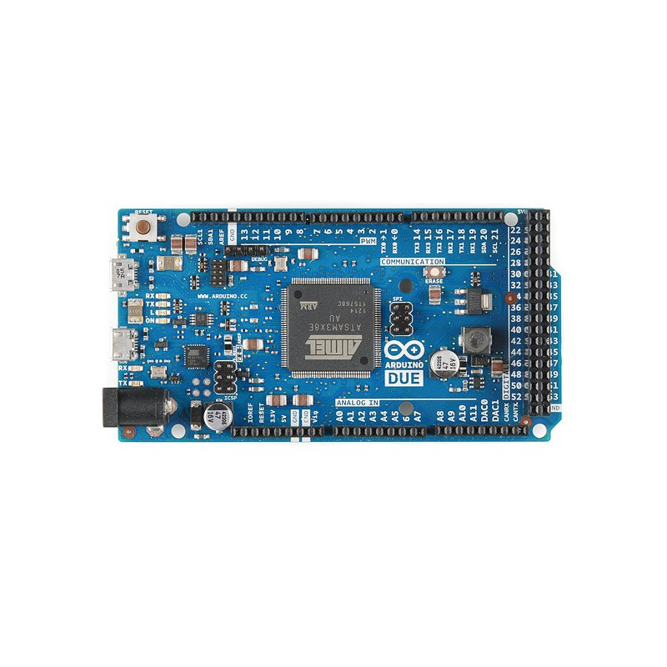
Microcontroller
This is the first ARM-based Arduino development board. This board is based on a powerful 32bit CortexM3 ARM microcontroller made programmable through the familiar Arduino IDE. It increases the computing power available to Arduino users keeping the language as compatible as possible so that many programs will be migrated in a matter of minutes.
Arduino Due

Slide 7
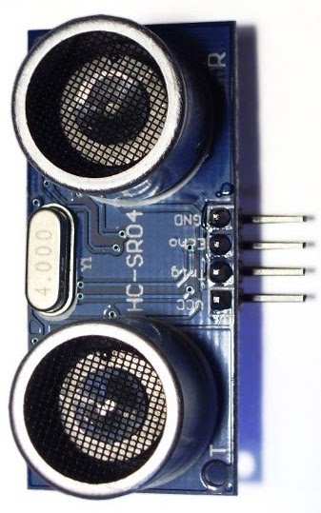
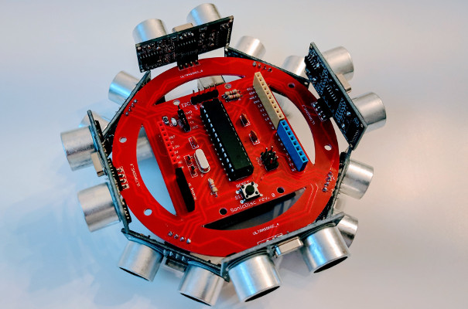
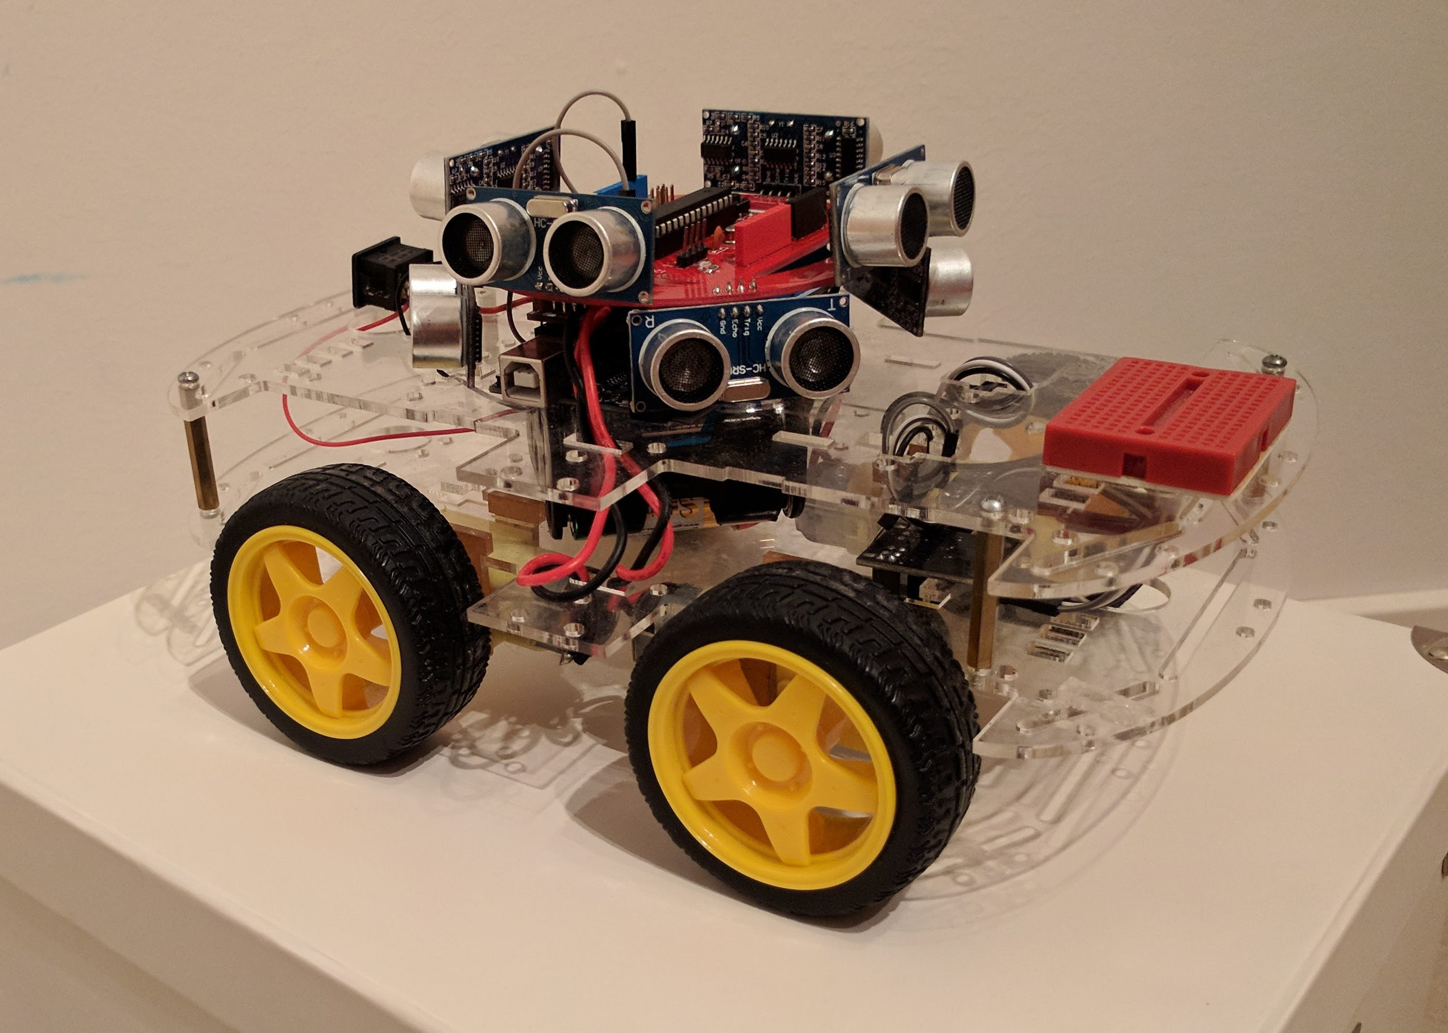
Ultrasonic Sensor
The HC-SR04 ultrasonic sensor uses sonar to determine the distance to an object like bats or dolphins do. It offers excellent range accuracy and stable readings.It operation is not affected by sunlight or black material like Sharp rangefinders are although acoustically soft materials like cloth can be difficult to detect.
Ultrasonic sensor HC- SR04

Slide 8
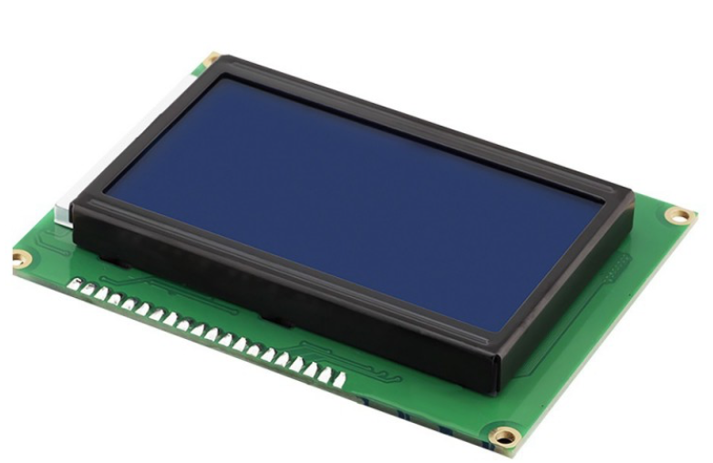
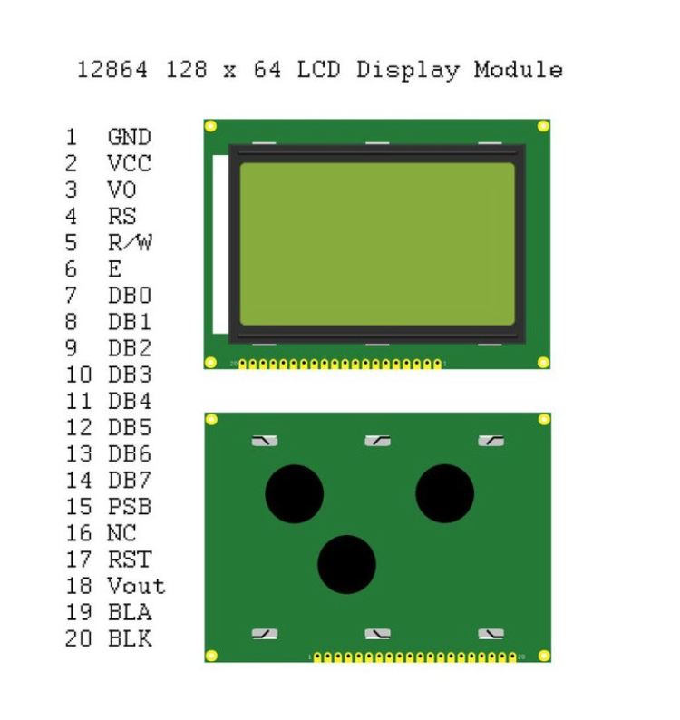
DISPLAY
LCD Graphic 128x64 Display
We will use liquid Crystals Display because it consumes less power , they are compatible with low power electronic circuit’s and can be powered for long duration.

Slide 9
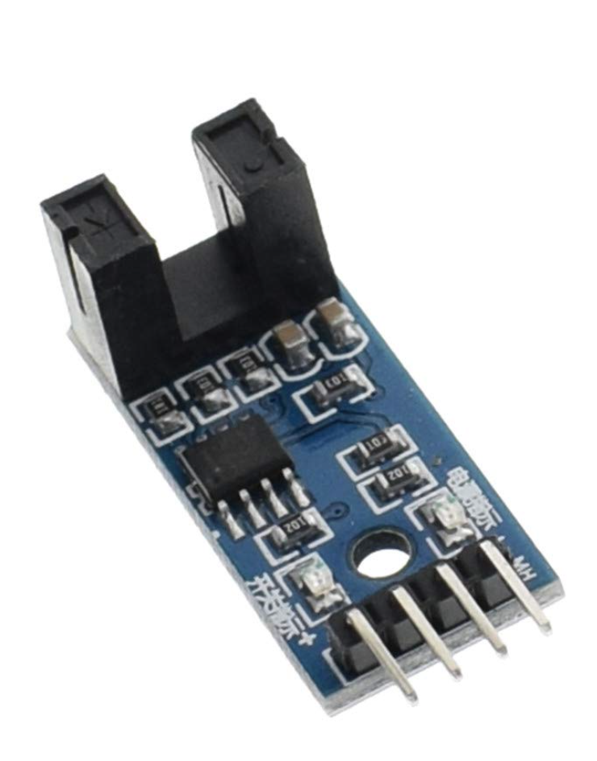
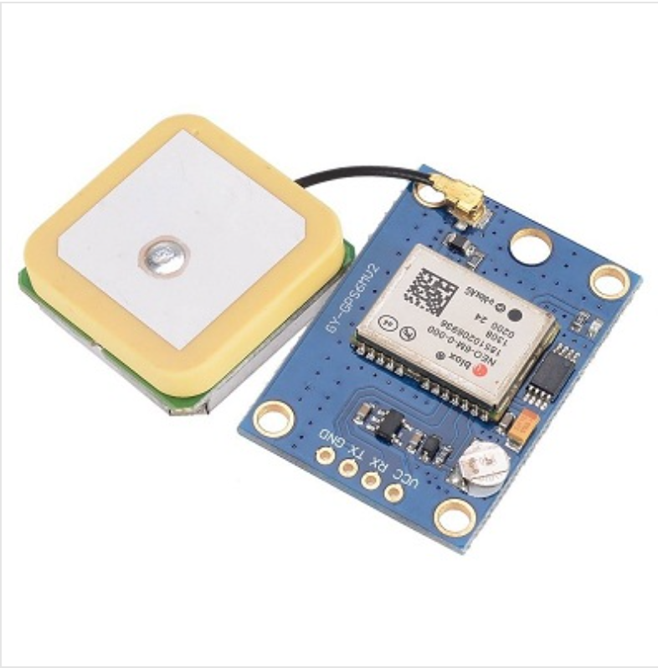
F249 4 PIN Infrared Speed Sensor - Widely used in motor speed detection.
GPS Module NEO6MV2 - Based on u-blox NEO-6M GPS module with on-board backup battery.

Slide 10
The main purpose of this part is to avoid collision of a vehicle form all side. we are not sure that using motor with ultrasonic sensor will be a wise decision or not .We also thought about using 4 ultrasonic sensor at 4 side of the vehicle rather than mounting it on top of the vehicle. When we will implement it practically we can be sure about it.

Slide 11
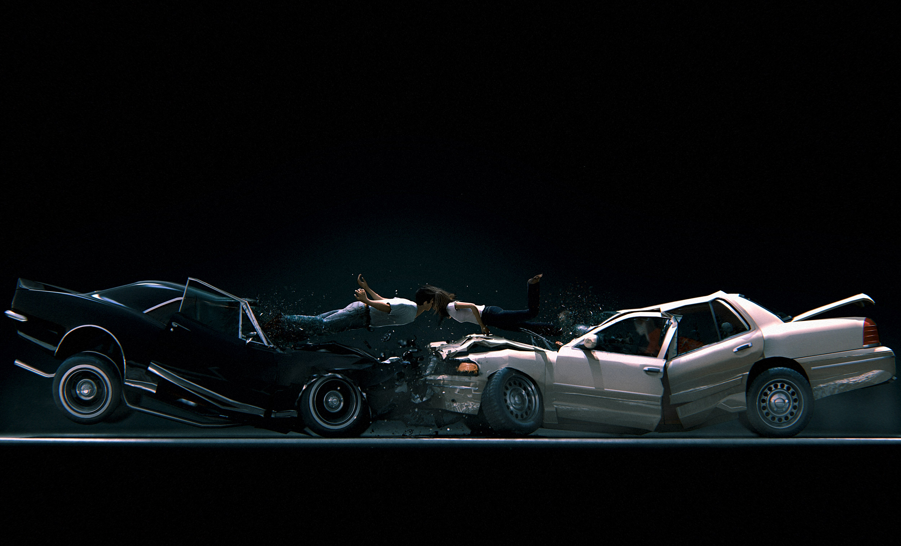
THANK YOU

